Slide 1
Data Engineering Boot Camp
Apache Spark

Slide 2
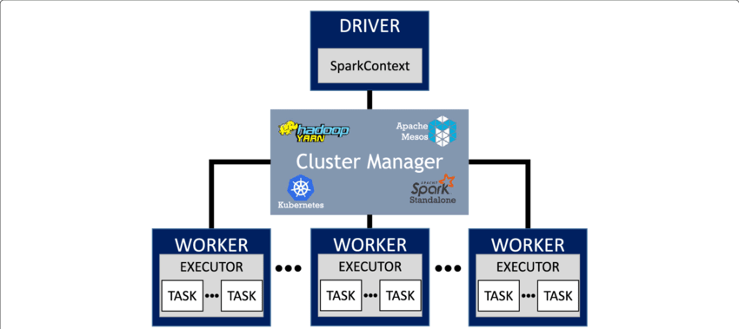
What makes Spark so exceptional?
Speed and efficiency:
Spark leverages RAM for lightning-fast operations.
It only writes to disk when absolutely necessary (operation spilling).
Unlike Hive or MapReduce, it minimizes bottlenecks.
Storage agnostic:
Read data from anywhere: relational databases, MongoDB, data lakes.
It decouples storage and compute, making it highly flexible.

Slide 3
How does Spark operate?
The Plan
Spark uses lazy evaluation, executing only when an action (e.g., count(), show()) is triggered.
Steps:
Creates an internal logical plan.
Optimizes the plan for efficient execution.
Executes the plan when an action is called.
The Driver
Orchestrates the job by:
Reading the plan and initiating jobs.
Distributing tasks to executors.
Monitoring task progress and rescheduling failures.
Collecting final results.
Key Settings:
spark.driver.memory: Adjust for large jobs to avoid OOM errors.
spark.driver.memoryOverheadFactor: Reserve extra memory for non-heap tasks.
Executors
Perform the heavy lifting by:
Executing tasks (e.g., filtering, mapping, reducing).
Writing intermediate results to disk or memory.
Reporting task status to the driver.
Key Settings:
spark.executor.memory: Prevent disk spilling with sufficient memory.
spark.executor.cores: Parallel tasks per executor (default = 4).
spark.executor.memoryOverheadFactor: Boost for complex UDFs.

Slide 4
Different Types of Joins in Spark
Join Type | When to Use | Key Characteristics | Performance
Shuffle Sort-Merge Join | Joining two large datasets | - Requires shuffle and sorting on both sides - Can handle large datasets but is the least performant | Low: High shuffle cost and processing time
Broadcast Hash Join | When one side of the join is small | - Avoids shuffle by broadcasting the smaller dataset - Executes in-memory for faster lookups | High: Efficient for small-to-medium datasets
Bucket Join | When datasets are pre-bucketed on join keys | - Avoids shuffle if bucket counts are multiples - Requires preprocessing with aligned buckets | High: Effective for large pre-bucketed datasets

Slide 5
How Spark Reads Data
From a Data Lake:
Delta Lake: A storage layer providing ACID transactions and schema enforcement.
Apache Iceberg: Table format supporting transactional updates and time travel.
Hive Metastore: Centralized metadata management for data lakes.
From an RDBMS:
Examples: Postgres, Oracle, etc.
Spark reads from relational databases via JDBC connectors.
From an API:
REST API Calls:
Spark can make REST API calls and convert responses into datasets.
Caution: REST calls usually occur on the driver node, which can create bottlenecks.
From Flat Files:
Formats: CSV, JSON, etc.
Spark supports direct reading of structured and semi-structured flat files.

Slide 6
Spark Shuffle
Is Shuffle good or bad?
Good: Handles low-to-medium volumes with ease.
Bad: At high volumes (>10 TB), it can wreak havoc.
How to minimize shuffle at scale:
Bucket the data if multiple joins or aggregations are downstream.
Use powers of 2 for bucket counts to ensure compatibility.
How Shuffle Partitions and Parallelism Are Linked
Shuffle Operations (DataFrames/SQL):
Higher spark.sql.shuffle.partitions leads to finer-grained parallelism.
RDD Operations:
spark.default.parallelism determines the number of partitions unless explicitly overridden.
Relationship Between the Two:
spark.sql.shuffle.partitions are specific to DataFrame/SQL API operations.
spark.default.parallelism is used for RDD operations, especially when no shuffle is involved.

Slide 7
Understanding Skew in Apache Spark:
How to Identify Skew?
Spark Job Progress:
Look for stages or tasks stuck at 99% completion for a long time.
Check Spark UI for partitions with unusually high data sizes or task durations.
Partition Size Analysis:
Uneven partition sizes in shuffle data indicate skew.
Box-and-Whisker Plot:
Visualize data distribution using a box plot to spot outliers with significantly larger partitions.
How to Handle Skew in Spark
Use Adaptive Query Execution (AQE)
spark.conf.set("spark.sql.adaptive.enabled", "true")
Salting
Add a random "salt" value to the skewed key to distribute it across multiple partitions.
Example: Instead of grouping by key, group by key + random_salt
Filter outliers: Handle large skewed data separately.

Slide 8
Essential Tips for Optimizing Spark
Avoid Overhead in UDFs (User Defined Functions) as they are often slower than Spark's built-in functions due to serialization and deserialization overhead.
Monitor and Debug following with Spark UI
Stage durations and task execution times.
Shuffle write/read sizes.
Skewed partitions.
Optimize Memory Usage
Memory mismanagement can lead to out-of-memory errors or frequent garbage collection.
Adjust executor and driver memory
Increase memory overhead for jobs with complex UDFs or shuffles

Slide 9
Spark Output Datasets
Why Partition Output by Date?
Partitioning:
Output datasets should almost always be partitioned by date.
This ensures efficient query performance and scalability.
Purpose of Partitioning:
To organize data by execution date or other relevant fields for faster access.
Common practice in big tech to partition large datasets by time dimensions (e.g., year, month, day).
Example: Partitioning in Big Tech
Large-scale data pipelines often write execution data partitioned by a specific field (e.g., date) to optimize for:
Query performance.
Data retention policies.
Scalability in downstream processing.

